Slide 1

Road accident analysis
Pratham Pathak
Anshul Aditya
Priyanshu suman

Slide 2

Content
INTRODUCTION
OBJECTIVE OF THE PROJECT
INFORMATION AND INSIGHTS
CHALLENGES
SOLUTION OR APPROACH
CONCLUSION

Slide 3
INTRODUCTION
Road accidents represent a persistent and critical challenge that transcends geographical boundaries, impacting communities globally. The repercussions of these incidents extend far beyond immediate physical damage, affecting individuals, families, and entire societies. As we navigate an era characterized by rapid urbanization, technological advancements, and increased vehicular density, comprehending the intricate dynamics of road accidents becomes imperative.
The subject of road accident analysis delves into the multifaceted aspects surrounding these incidents, aiming not only to decipher the causes but also to develop effective strategies for prevention and mitigation. This research seeks to unravel the intricate web of factors contributing to road accidents, encompassing human behaviors, environmental conditions, and vehicular elements.

Slide 4

Objective of the project
This road accident analysis endeavors to achieve several crucial objectives. Firstly, it aims to discern the primary causes behind the escalating rates of accidents on our roads. By dissecting these incidents at a granular level, we can identify patterns, trends, and potential correlations that underpin their occurrence.
This research seeks to explore the diverse array of factors influencing road accidents. From human-centric variables such as distracted or impaired driving to environmental elements like adverse weather conditions and inadequate road infrastructure, a holistic examination is essential.

Slide 5
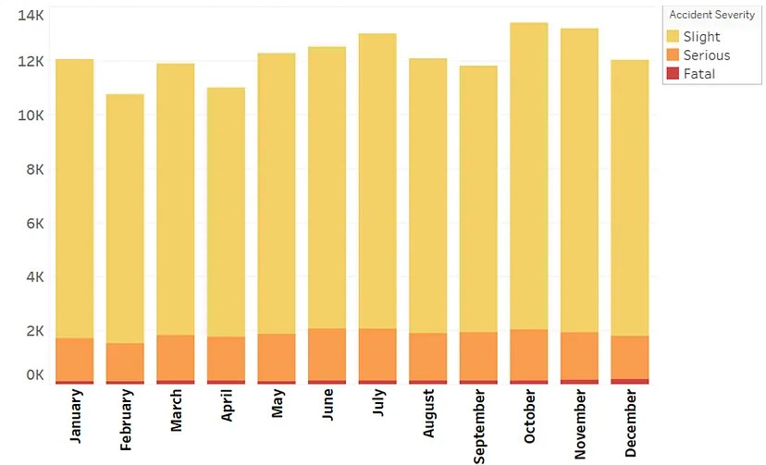
Information and Insights
Fig.1

Slide 6
CHALLENGES
1. Data Quality and Availability:
Incomplete Reporting: Many accidents go unreported, leading to incomplete datasets that may not accurately reflect the true magnitude of the problem.
Data Discrepancies: Inconsistencies in reporting standards and practices across jurisdictions can hinder cross-comparison and analysis.
2.Environmental Influences:
Weather Conditions: Adverse weather, a significant factor in accidents, introduces dynamic and unpredictable elements that complicate analysis.
Road Infrastructure Changes: Ongoing modifications to road infrastructure can impact accident patterns but may not be immediately reflected in historical data.

Slide 7
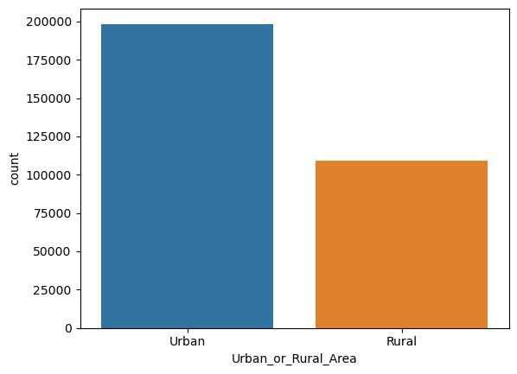
Accidents in Urban and Rural areas.

Slide 8
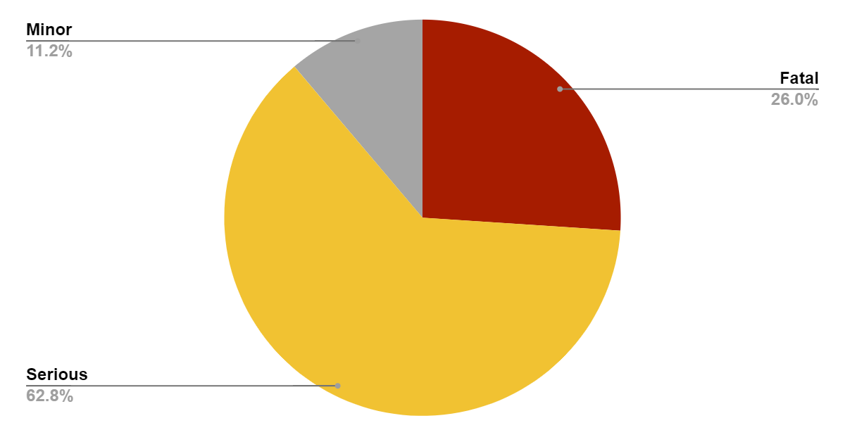
Categorisation of road traffic crashes
Fig.2

Slide 9
Solution or approaches
1. Advanced Data Integration and Standardization:
Implement standardized reporting protocols globally to ensure consistency in data collection.
Leverage advanced technologies such as machine learning algorithms to fill gaps in data and enhance the accuracy of accident analysis.
2. Smart Infrastructure Development:
Invest in intelligent road infrastructure that adapts to changing conditions, such as variable speed limits based on weather and traffic patterns.
3. Technological Advancements:
Promote the development and integration of autonomous vehicle technologies, which have the potential to significantly reduce accidents caused by human error.

Slide 10

Conclusion
In the intricate tapestry of road safety, our journey through the analysis of road accidents has unveiled a landscape marked by challenges and complexities. Yet, within this landscape lies the opportunity to transform our roadways into safer, more resilient conduits for societal progress. As we conclude our exploration, several key takeaways emerge, guiding us toward a future where the specter of road accidents is mitigated through informed strategies and collective commitment.
The foundation of our proposed solutions rests upon the availability and reliability of data. Standardizing reporting practices, harnessing advanced technologies for data enhancement, and fostering international collaboration in data sharing are essential steps toward building a robust foundation for comprehensive accident analysis.

